Slide 1
OPDC Let’s Talk: Student Rental Wednesday, February 15, 2023 | 6:00PM
Trisha Margiotti
she | her | hers
Property Manager Liaison
University of Pittsburgh
Off-Campus Living, Division of Student Affairs

Slide 2
Mission Statement
We are committed to ensuring that students are knowledgeable renters. Our mission is to provide students with the information and tools needed to successfully reside in off-campus accommodations. Our services can help you find housing and roommates, resources to safely live off-campus, and the support you’ll need to be a responsible neighbor – from renter’s guides to apartment listings to useful tips, we’re at your service.

Slide 3
What we do…
Educating and supporting students to thrive in Off Campus Living Experiences
We accomplish this by: Helping students make informed choices about housing and roommates
Encouraging students to become knowledgeable and responsible tenants
Assisting students in gaining the proficiency to solve problems when landlord and roommate difficulties arise
Becoming a “Good Neighbor” and being active in the Community. Developing student awareness of community values and responsibilities.

Slide 4
What you need to know before student signs a lease
Rental Applications
Before your student signs a lease, it’s crucial that they read and understand the document fully. It tempting to skim through it, but they miss important information in a legally binding contract.
Co-Signers are usually required
Jointly and Severally - This is where your student and their roommates are jointly responsible for paying rent in full and any damages caused. In other words, the student is responsible for their roommate’s share of the rent and repair costs. While we often don’t see this, it’s worthwhile to consider what could happen if your student ends up in this scenario and how they might handle it.
Occupancy limits
.
1

Slide 5
Occupancy Limits
THREE’S COMPANY FOUR’S A CROWD!
City of Pittsburgh code states no more than three unrelated individuals are permitted to reside together in one rental housing unit. Even if the housing unit has five bedrooms, no more than three are allowed to live in one unit.
Breaking this code may result in fines to the landlord, evictions, and other out adverse outcomes.
You are within your rights as a potential tenant to ask for a copy of the Certificate of Occupancy referred to as “occupancy permit”) issued by the City of Pittsburgh.
*Be a Good Neighbor Student Guide, University of Pittsburgh

Slide 6
Types of leases and responsibilities
If your student chooses to live with roommates, make sure they know if they have an individual liability lease or a joint and several liability lease. The most common type of lease is a joint and several liability lease. This is where your student and their roommates are jointly responsible for paying rent in full and any damages caused. In other words, student is responsible for their roommate’s share of the rent and repair costs. We often don’t see this, it’s worthwhile to consider what could happen if your student ends up in this scenario and how they might handle it. Encourage your student and their roommates to sign a roommate agreement before moving in.
Tenant responsibilities
Student should know their specific responsibilities under the lease agreement, such as:
Rent payment process, due dates and late fees
Utilities
Lawn maintenance
Snow removal
Trash disposal
Repairs
The lease end date and time
Move-out and cleaning requirements
Additionally, make sure your student knows if there is a clause requiring them to leave the heat on at all times during the winter. Water pipes can freeze during Pittsburgh winters, causing major damage for which your student and roommates would be financially responsible.

Slide 7
Other helpful tips…
Check if a written notice to terminate the lease is required. This could be required even if the lease ends on a particular date. If you don’t comply with a notice requirement, you could end up paying rent after the lease has ended.
Take note if there is an attorney’s fee clause and under what circumstances you would be required to pay your landlord’s attorney’s fees.
Look for any administrative fees you are required to pay and whether you are receiving any type of service for those fees. Also, see if there are fines and costs in addition to rent and under what circumstances they are assessed.

Slide 8
Other helpful tips…
Check if a damages move-in sheet is required and when it is due to the landlord. Some leases state that if you fail to turn in your check-in sheet on time, you accept the residence “as-is” and could be charged for damage caused by a previous tenant.
Make sure that all promises or representations made by the landlord are in writing. If anything is discussed about the residence with the property manager, make sure it’s added to the lease before signing.
Know if there is a way to get “out” of the lease, such as an early termination clause or subletting or assignment clause, and, if so, under what conditions.
Make sure the landlord is required to give notice prior to entering a residence.

Slide 9
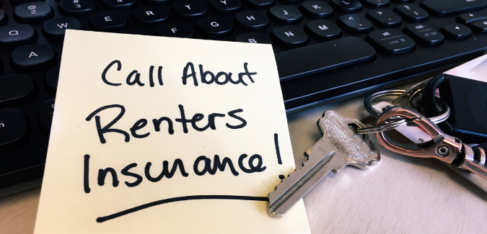
Renters Insurance
Students residing in off-campus accommodations should consider buying renter’s insurance to protect their personal property from catastrophic events, such as fire, flooding, or theft.
In an event such as these, renter’s insurance could provide you with a stipend for temporary housing and meals while your rental property undergoes repairs. Renter’s insurance may also protect you against personal liability in claims or lawsuits. It is recommended that you purchase a policy that includes protections for both your personal property and personal liability.
Student should be aware property owners are never responsible for personal belongings under any circumstances.

Slide 10
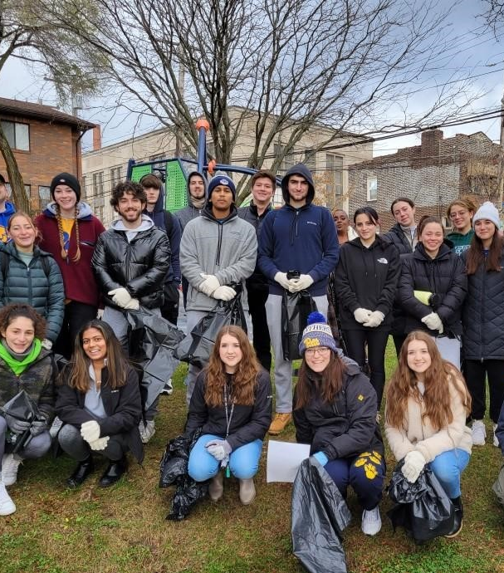
Be A Good Neighbor…
We work collaboratively with Office of Engagement & Community Affairs and Office of Government Relations and Advocacy and local neighborhood organizations to help our students living in off-campus accommodations learn what it means to be a good neighbor. The initiative educates students on how they can have a lasting impact on local neighborhoods and encourages responsible behavior while residing off-campus. Programming within the Be a Good Neighbor initiative includes block parties, tenant workshops, publication of a student guide, and more.

Slide 11
Trisha Margiotti Property Manager Liaison University of Pittsburgh Off-Campus Living Division of Student Affairs 412.648.5432 marg9@pitt.edu|
www.ocl.pitt.edu

